Slide 1

100 Day Plan
MSO Presentation
Wed March 17, 2015 at 2 pm EST

Slide 2
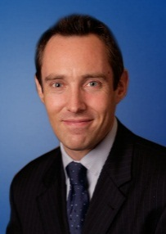
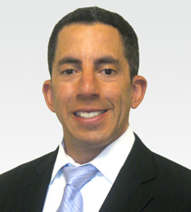
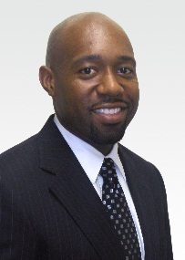


Today’s Presenters
Keats Aiken
Deal Advisory – PE
Scott Novick
M&A Tax
Dean Bell
Deal Advisory – AAS
Jay Teinert
Deal Advisory – ISA
Braden Mark
Deal Advisory – PE

Slide 3
Our Agenda and Schedule
Overview
What is a 100 day plan?
Why do it? 15 min
Frequency of usage and post-close wins
Execution
Planning
Topics/issues to include 15 min
Tools
Six Recent Examples 25 min
Our Four Specific Asks of You 5 min

Slide 4


Overview

Slide 5
What is the 100 day plan?
What is the 100 day plan?
The “100 day plan” refers to the actions we suggest be taken (by client or target management) or that need to be taken (e.g., tax elections) during the first 100 days post-close. These actions cover a wide range of functions – accounting, finance, integration, tax, HR, etc. It’s highly likely that companies need action to be taken in one or more of these functions for the smooth integration of the transaction.
What is KPMG’s 100 day plan product/deliverable?
Our FDD, M&A Tax and other teams are well-positioned to add value to the client’s broader post-closing strategy. During the due diligence (DD) process, we gather significant data and have meaningful interactions with target management. This provides us with the knowledge and insights to help identify risks and opportunities to address post-close. Our deliverable can:
Provide a high-level description of potential value creation and risk mitigation considerations (relating to post-close activities) that have been identified during the diligence process and prioritize such items.
Increase our client’s awareness and focus on post-close issues and opportunities. This increased awareness, therefore, acts as a catalyst to win work after our due diligence assistance has been completed.
Help facilitate a discussion with clients regarding post-close deal issues. The goal is to capture the full potential of pre- and post-deal engagement opportunities.

Slide 6
Why should we do it?
Key Benefits
Convey post-close DD insights to clients in a standardized and consistent approach
Our DD reports often do not contain summary slides on “post-close considerations and near-term to do’s”
Stay engaged throughout the broader transaction cycle
Capture full potential of pre- and post-deal close engagement opportunities
We frequently move on from deals with limited follow-up on known issues and opportunities
Five objectives of the 100 day plan
Provide additional value-add insights for our clients
Differentiate our DD product
Stay involved throughout the broader transaction cycle
Increase awareness of and focus on post-close issues and opportunities
Improve service network teaming and pull-through during diligence and post-closing
Some Obvious Benefits for our clients
Leverage knowledge and streamline the diligence and post-close process
Maximize deal value
Help integrate smoothly and efficiently by prioritizing action steps
Reduce risk that something gets missed (e.g., transfer tax returns)

Slide 7
Why should we do it? Identifying post-deal value during diligence
“What Do Private Equity Firms Say They Do?”
In a December 2014 survey, 79 private equity (PE) investors with a total of over $750 billion of assets under management were surveyed about their practices in firm valuation, capital structure, governance, and value creation. The survey indicated that on average, PE investors “commit meaningful resources to add value, although there is a great deal of variation in how they do so.”
According to the survey, three types of value increasing actions exist, both before and after investment:
Financial engineering – Providing strong equity incentives to management teams of their portfolio companies
Governance engineering – Controlling the boards of portfolio companies and remaining actively involved in governance
Operational engineering – Developing industry and operational expertise to add value
The following slide illustrates the results of one survey question asked of PE investors (what are the key sources of value creation identified on a pre-investment basis?) and how the responses (the sources of deal value) match our service offerings.

Slide 8
Why should we do it? Identifying post-deal value during diligence
36.8%
27.1%
Per PE investors, the % of deals that outside consultants actively participated in identifying sources of value (on pre-investment basis)
Per PE investors, the % of deals that outside consultants actively participated in identifying sources of value (on post-investment basis)
In a survey of 79 PE firms, deal professionals identified the key sources of pre-investment value creation. The table below lists the top sources of value creation, the percentage of deals in which each source was identified as a value driver on a pre-investment basis, and the KPMG service lines we should be bringing into deals during and post diligence.
Sources of value creation | % of deals | KPMG aligned services
Increase revenue/ improve demand | 70% | Strategy (growth strategy) – Market entry, channel strategy, new product development, customer analysis and segmentation Strategy (sales effectiveness) – Sales force effectiveness, pricing strategy, trade and promotional spending analytics
Improve incentives | 61% | Integration & Separation (compensation and benefits) - Align rewards programs with business strategy and human capital objectives
Follow-on acquisitions | 51% | FDD/ITD/M&A Tax/etc. - Assist with diligence, structuring, and related transaction advice Integration & Separation - Assess and execute integration/separation of business across all corporate functions.
Facilitate a high-value exit | 50% | FDD/ITD/M&A Tax/ISA/Strategy (sell side services) - Planning and implementing divestiture-related activities and presale evaluation through closing and post-closing requirements. Eliminate stranded costs and diseconomies. AAS (IPO readiness) - Help prepare to meet financial reporting, SOX, and other regulatory requirements
Improve corporate governance | 47% | R&C (enterprise risk management) - Identify, assess, and develop a strategic risk profile R&C (governance, risk, and compliance) - Integrated framework that links corporate governance, enterprise-wide risk, compliance, and assurance functions to achieve a consistent and holistic vision across the organization
Reduce costs in general | 36% | Strategy (performance improvement) – Complexity reduction, operating efficiency, SG&A cost reduction, and working capital efficiency diagnostics; subsequent implementation (in partnership with MC functional specialists) Integration & Separation – Synergy, stranded cost and diseconomies identification, validation and tracking
Redefine business model/ strategy | 34% | Strategy (enterprise strategy) – Enterprise-wide business strategy intended to fundamentally reposition the business in the marketplace, redefine its value proposition, and reorganize required capabilities Strategy (performance improvement) – Complexity reduction, operating efficiency, SG&A cost reduction, and working capital efficiency diagnostics; subsequent implementation (in partnership with MC functional specialists) Integration & Separation/MC – Assist in development, alignment, and stabilization of interim/target operating model
Improve IT/Information services | 26% | Strategy/MC (enterprise solutions) - Implementation and management of enterprise software Strategy/MC (technology consulting and enablement) - Integration, automation, mobility, and assurance services Integration & Separation (IT due diligence) – Assess current/future IT operating models, including risks and budget
Introduce Shared Services | 15% | MC (shared services & outsourcing) - Assist in design and management of shared services models to realize productivity gains and cost savings
Source: “What Do Private Equity Firms Say They Do?”; Gompers, Kaplan, and Mukharlyamov

Slide 9
Evolution of the initiative
Observations
Initial pilot program in Q1 & Q2 of FY13 yielded strong results.
Full rollout at March 2013 Partner meeting.
After initial increase in usage, a slow quarterly decline through FY14, followed by increases in the Q1-15 and Q2-15 through February.
As noted below, the percentage of partners using the 100 day plan increased significantly in FY14; 25 partners/MDs and their teams executed a 100 day plan more than twice.
Given its importance, the 100 day plan is now incorporated into M&A tax partner/MD goal setting with 100% compliance mandated.
FY13 Usage
FY14 Usage
FY15 YTD (February) Usage

Slide 10
Reported sell-through, post-close wins
Observations
Of the 57 partner and MD responses (80% response rate), a total of 24 post-close wins have been reported in the YTD 2015 period, compared to 33 in all of 2014.
Approximate value of these sell-through, post-close wins in 2014 was $20.5 million, compared to $9.7 million in the YTD 2015 period, a portion of which represent recurring revenue (e.g. audit and some tax work).
Common sell-through services include a wide range of integration projects, closing balance sheet diligence (i.e. true-up working capital), financial statement audits, and purchase price allocation.
Note: The data in the charts above was derived from the responses of 48 partners and managing directors. It does not represent a complete population of wins and/or sell-through, post-close win value.

Slide 11

Execution

Slide 12
Key considerations
Planning with the 100 day plan in mind
Scoping - Take a holistic approach to the transaction, incorporating other service lines into the due diligence, even if only on a limited scope basis, e.g. plant tours, cursory IT diligence, transfer pricing.
Engagement letters – Consider including a specific procedure for the 100 day plan (see example language in FDD Toolkit).
During Diligence
Execute with a plan for delivering the 100 day plan. This will enable you to think earlier about likely post-close issues and opportunities. Include these in an issues list/log.
Communicate with your client throughout the engagement about the potential post-close items that may be necessary or warranted.
Gather feedback from core diligence teams throughout and at the end of diligence to create a comprehensive 100 day plan deliverable.
Pull in other service lines (Strategy, Integration/Separation, MC, RC, etc.) early for participation in diligence and input to the deliverable.
Know your client and keep their buying behavior in mind. What pre- and post-close services do our clients buy? How do they scope such services? Who at the client organization makes the buying decision and how?
After diligence (ideally between signing and close)
Aggregate ideas from the team and create a tailored 100 day plan. Size and complexity of transaction will help shape the deliverable.
Consider including other value-add items (e.g. credit agreement timeline, collateral for post-close services, etc.).
Send and follow up!

Slide 13
Example engagement letter language
Your First 100 Day Plan, Including Integration Matters Based on the knowledge we gain during our due diligence engagement, discuss key milestones or potential business improvement opportunities for your first 100 days of ownership. Our comments may focus on:
Revenue or pricing improvement opportunities
Potential cost savings and margin improvement opportunities
The quality of reports and tools available for management to run the company
Accounting close process and procedures concerning cut-off and reporting capabilities
Current IT system and the needs for system redesign, if applicable
The integration and separation needs, including systems, financial, tax and operational matters
Opportunities for tax savings post-close
Post-closing tax compliance matters
Closing requirements under the SPA
Post-closing accounting, disclosure and valuation matters.

Slide 14
Risk management matters
EL includes 100 Day Plan Procedure(s) | No 100 Day Plan EL Procedures
Disclaimer language (in front or back of document) Electronic transmittal language in email | Risk management language addressing work product we were not engaged to perform or paid to provide
Language indicating that the document represents our observations from diligence and is not intended to be 100% inclusive of all matters/issues our client may need to consider.
Template language to be added to the 100 Day Plan Toolkit online.

Slide 15
Common topics/issues
Financial
New auditors
Assisting with the Post-Close Working Capital Adjustment mechanism
Purchase price allocation/valuation/opening BS
Accounting integration/revise accounting policies
IPO readiness (operational considerations, as well)
Analysis of Key Cash Flow Drivers, including Profitability by Product, Customer, Segment, End-Market, Finance Integration etc., for purposes of compiling a profit improvement plan
Harmonizing GL Classifications and Speed-to-Close
Tax
Tax compliance – outsource or new provider
Check the box elections
338 elections
Finalize IRC §382 analysis based on closing date balance sheet and final purchase price
Transaction Cost Analysis
Tax basis studies/Cost Segregation
Tax basis step-up/purchase price allocation
Transfer Pricing reports
Transfer taxes and filing obligations
Reverse sales and use tax audits
R&D (and other tax credit ) reviews
File voluntary disclosure agreements
Operational
Integration – PMO and workstream expertise across financial and operational matters (ISA)
Redefine business strategy (Strategy)
IT System & Process Redesign opportunities (including tax transformation and technology) (Strategy/ISA)
Redesigning and improving management reporting packages and how the management team monitors and drives the business (AAS/MC)
Cost elimination/reduction of overhead (Strategy/ISA)
Budgeting and forecasting process and tools (AAS/MC)
Employee Incentive Plans – Align with business strategy (ISA)
Improvement of Cash Management/WC (Strategy/MC)
IT staffing and processes (Strategy/ISA)
Sales effectiveness and growth strategy (Strategy)
Improving corporate governance (controls, ERM, GRC) (RC)

Slide 16
Low Hanging Fruit – example language (1)
Working Capital and Other SPA Mechanisms
Within [60] days of close, deliver the final calculation of Net Working Capital, Cash on Hand, and Indebtedness. Prepare and provide an information request list to facilitate your procedures over the Final Purchase Price schedules.
Perform specific procedures over key account balances as of the closing date, including accounts receivable and related reserves, prepaid expenses, inventory and related reserves, accounts payable, and accrued expenses.
Purchase Accounting and Valuation
Ensure proper cut-off procedures are performed at closing date and transactional data is appropriately segregated under the “new” company. Engage in conversations with auditors and advisors to understand potential complexities anticipated in purchase accounting. Further, develop a detailed plan regarding the requirements surrounding the preparation of closing and opening financial statements.
You will need to engage a third party to assist with the fair value determination of certain assets and liabilities being acquired and to allocate the purchase price to all identifiable assets and liabilities.
Determine appropriate technical accounting treatment for specific issues, such as[replacement of share based compensation and the treatment of the debt restructuring as a modification or extinguishment.
Consider the need to similarly perform a valuation for tax purposes in step-up transactions.
IPO Readiness
In anticipation of a future capital markets event, consider performing:
An evaluation of accounting policies to ensure SEC compliance.
A readiness assessment of the company’s internal control environment over financial reporting, including the identification of business processes, systems and procedures subject to financial statement reporting.
An assessment of other governance infrastructure, processes, and policies in consideration of SEC and PCAOB requirements.

Slide 17
Low Hanging Fruit – example language (2)
Review tax allocation and final year tax return
Per section [xx] of the SPA, evaluate the calculation and allocation of current year taxes and review the company’s final year tax return prior to filing.
Entity Classification Election
File Form 8832 to treat [Entity Name] as a disregarded entity for US federal income tax purposes. Such election is to be filed not more than 75 days after the date on which the election is to take effect.
Transaction Cost Analysis
Perform an analysis to determine which transaction costs qualify for deduction for tax purposes. Absent proper contemporaneous documentation, a significant portion of costs may have to be capitalized and amortized instead of currently deducted.
Real Estate Transfer Tax (RETT) Filings
Per section [xx] of the purchase agreement, [You] are responsible for filing the appropriate tax returns and payment of RETT.
Quantify the magnitude of real estate transfer tax due, based on the valuation to be performed, and prepare the necessary returns. [State A’s] RETT return is due within [xx] days of closing and [State B’s] RETT return is due within [yy] days of closing.
Appoint new auditors and tax advisors:
Consider the need to appoint new financial statement auditors and tax advisors, due to issues noted during diligence. Going forward, your audit and tax providers will require an increased level of specialized knowledge and experience to address the likely increased complexities associated with:
The growth of your business
Global expansion
Your potential future capital markets event
More sophisticated tax structure
Post-acquisition tax planning.

Slide 18
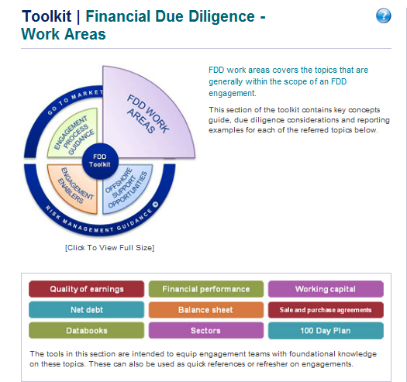
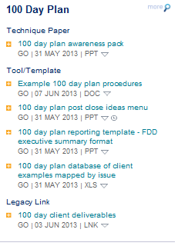
Deal Advisory tools and resources (1)
Note: All the above tools are available in the FDD Toolkit.

Slide 19
Deal Advisory tools and resources (2)
 | Tool/Template | Description | Slide Example
1 | Awareness pack | Provides an overview of the 100 day plan, its objectives, opportunities and solutions. The pack also provides a brief description of the pilot program.
2 | Reporting templates | Templates that DD engagement teams can use to report on the 100 day plan observations and recommendations. | 
3 | Post-close ideas menu | List of questions and/or triggers to identify post-diligence issues and potential service opportunities | 
4 | Example deliverables | Examples of client deliverables issued so far (growing repository) | 
5 | Mapped examples by topic | 100 day plan deliverables issued to clients mapped to each of the triggers in the post-close ideas menu
6 | Engagement letter procedures | Example full menu of engagement letter procedures, including non FDD procedures

Slide 20








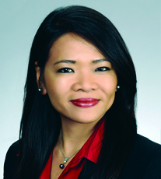




Integration & Separation Advisory (ISA) Partners and MDs Primary (P) and Secondary (S) Points of Contact
 |  |  | Partners |  |  |  |  |  |  | Managing Directors
Name |  |  | Steve Miller | Matt Cowell | Micky Houston | John Luce | Preston Parker | Jay Teinert | Tiberius Vadan | Brendan Collins | Jeff Dufty | Joanne Heng | David McKee | Paul Musselman | Doug Rodriguez | John Steele
Office |  |  | Houston | Chicago | Dallas | Chicago | Tysons | Dallas | NYC | Boston | Chicago | LA | Atlanta | SVO | Chicago | Tysons
Cell Phone |  |  | (281) 216-5016 | (312) 405-7294 | (214) 675-4166 | (312) 912-1299 | (703) 585-9997 | (214) 708-6787 | (917) 941-9000 | (774) 248-0549 | (312) 305-8029 | (917) 714-8266 | (404) 229-2454 | (650) 422-8113 | (269) 876-9395 | (847) 456-4709
Industries | ENR |  | S |  |  |  |  | P
 | Chemicals |  |  |  |  |  | S | P
 | Utilities |  |  |  |  |  | S | P
 | HCLS |  |  |  |  | S | P
 | Med-Device |  |  |  |  |  | S |  |  |  |  |  |  |  |  | P
 | Tech (TMT) |  |  |  |  |  |  |  |  | S |  |  |  | P
 | DI |  |  |  |  | P |  |  |  |  |  |  |  |  | S
 | A&D |  | S |  |  |  |  |  |  |  |  |  |  |  |  | P
 | Auto |  |  |  |  |  |  |  | S |  |  |  |  |  | P
 | FS (non-bank) |  |  |  |  |  |  |  | P |  |  |  | S
 | Banking |  |  |  |  |  |  |  | S |  |  |  | P
 | CP |  |  |  |  |  |  |  |  | S |  |  | P
Functions | IT |  |  |  | P |  |  |  |  |  |  | S
 | Finance |  |  |  |  |  |  |  |  |  |  |  |  |  | P | S
 | Human Capital |  |  |  |  | P |  |  |  |  | S
 | HRTS |  |  | P
All ISA Partners and MDs have experience with both integrations and separations.
For speed, please feel free to contact both the Primary and Secondary leads at the same time.
Contact John Luce as primary DI lead; copying a local Partner/MD when appropriate. All ISA Partner/MDs have DI experience, but industry alignment takes priority over geography.
Please also reference the “T&R Top Accounts by Sector” excel sheet for specific partner/MD points of contact on certain accounts.
ENR = Energy and Natural Resources
Chemicals = Chemicals and Refining
HCLS = Healthcare & Life Sciences
Med Device = Implants and Equipment
TMT = Hardware & Software Technology
DI = Broad Diversified Industrials
A&D = Aerospace and Defense
Auto = OEMs and Suppliers
FS = All non-banking Financial Services
Banking = DA teams with RC on banking
CP = Consumer Products, including Retail
When in doubt, please call practice lead Steve Miller (281-216-5016),who can help identify the right person and/or accelerate a response.

Slide 21






































KPMG Strategy – 100 Day Plan Key Contacts
Partner and MD organization overview
M&A Strategy
Strategic Capabilities
Alex Miller Strategy Practice Leader Partner
312-665-1325 Chicago, IL
Dan DenBoer
Performance Improvement
Partner
480-459-3613
Chicago, IL
Sig Shirodkar
Org Strategy
Partner
973-912-6536
Short Hills, NJ
Karen Avery
Risk & Regulatory
Partner
212-954-4550
New York, NY
Sid Mohasseb
Innovation
Managing Director
949-885-5625
Irvine, CA
Mark Golovcsenko
Due Diligence
Managing Director
212-954-2373
New York, NY
Jos Plessers
Due Diligence
Managing Director
312-665-3418
Chicago, IL
Industry Specialties
FS
HCLS
ENR
C&R
Industrial Markets
Mitch Siegel
Strategy Team Lead Partner
404-222-3263 Atlanta, GA
Pharma
Payors
Andy Steinhubl
Partner
713-319-2614
Houston, TX
Dan Shaughnessy
Strategy Team Lead Partner
404-222-3684
Atlanta, GA
Tom Mayor Partner
216-875-8061
Cleveland, OH
Mark Ginestro Partner
415-963-5488
San Francisco, CA
Rana Ganguli
Managing Director
212-758-9700
New York, NY
Banking
Oil & Gas
CPG
Todd Dubner Partner
212-954-7359
New York, NY
Dan O’Keefe
Strategy Team Lead Partner
404-222-1806 Atlanta, GA
Paul Saias
Partner
312-665-2516
Chicago, IL
Providers
Chris Click
Partner
214-840-8061
Dallas, TX
Ashish Garg
Managing Director
617-988-1101
Boston, MA
Cynthia Ambres Partner
213-817-3141
Los Angeles, CA
Larry Oglesby Partner
404-222-7170
Atlanta, GA
David Montes
Managing Director
404-979-2115 Atlanta, GA
Olli Valikangas Managing Director
312-665-3436
Chicago, IL
TMT
Peter Gilmore
Partner
703-343-2392
McLean, VA
Alex White
Managing Director
212-954-2815
New York, NY
Tech
Rob Vanderwerf Strategy Team Lead Partner
949-885-5580
Irvine, CA
Kevin O’Laughlin
Partner
617-988-1124
Boston, MA
Tim Ramsey
Managing Director
404-222-3000 Atlanta, GA
Tom Hiddemen Managing Director
512-320-5115
Austin, TX
David Bard
Partner
212-954-6724
New York, NY
JD Brewer
Managing Director
919-576-9551
Raleigh, NC
Damian Morgan
Managing Director
312-665-2445
Chicago, IL
Bob Ruark
Managing Director
704-371-5271 Charlotte, NC
Samir Ajmera
Managing Director
408-367-7620
Santa Clara, CA
Power & Utilities
Bill Shew
Partner
617-988-1410
Boston, MA
Jonathan White
Managing Director
404-222-3378
Atlanta, GA
A&D
Insurance
Phil Wong
Partner
617-988-6332
Boston, MA
Bill Lakenan
Partner
404-222-3598
Atlanta, GA
Tom Nodine
Partner
Legend:  = Practice Leader
Legend:  = Practice Leader  = Strategy Practice Leader;
(1) = Strategy Leadership Team member

Slide 22
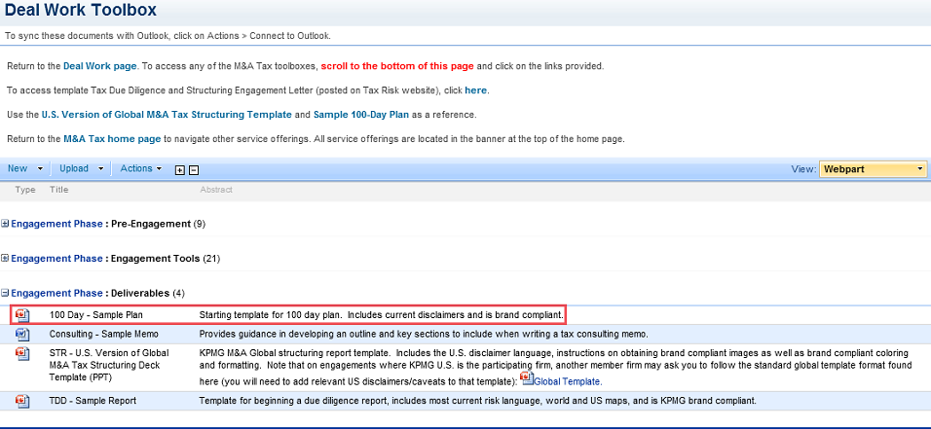
M&A Tax tools and resources
Deal Work Toolbox*** Brand and risk-compliant 100 day plan template
***
Note: The Deal Work Toolbox is only available to M&A Tax professionals.

Slide 23
Tax Contacts – Post-deal recommendations
 | East Region |  |  |  |  |  | West Region
 | Boston | New York Metro | Philly | Tysons | Atlanta |  | Chicago | Dallas / Denver | Houston | Santa Clara/San Fran | LA
PDR Lead | Monica Sardana | Scott Novick (National Lead) | Harmony Preston | Katya Gimbel | Mitchell Thweatt |  | Anthony Berceau | Steven Qualls | Patrick Kessler | Tim Berry (Santa Clara) David Hathcoat (San Fran) | Sergei Mytko
CAB | Dana Fried | Robert Delgado & Dana Fried |  | Toby Ruda | Toby Ruda |  | Andrea Dudek & Robert Delgado |  |  | Robert Delgado | Robert Delgado
IES | Stuart Taylor | James Seymour |  | Roger Koferl | Cordella Scott |  |  |  | Christina Kern
International Tax | David Young | Victor Gatti |  | Jim Sams | Hal Davis |  | Cara Harrison & Matt Schimka |  | Alex Hanhan |  | Neal Sheth
AMCS | Michele Prettie | Stephen Borman | Panayiotis Voutsinas | Darrin Holley | Robert Ford & Ben Rohrer |  | Violet Goodheart |  | Tracey Baird |  | Kirk Ewell/Bob Scharlach
VAT | Lionel van Rey | Anthony Ng |  | Frank Sangster | Nigel Li Fo Sjoe & Sandra McGrath |  | James Freed & Brian Groome
SALT | Darren McCarthy | Darren McCarthy & Bob Buckley |  | Dan McGuire | Mike Raley & Jim Kelleher |  | Karen Boyaris |  | Bobby Bui |  | Rob Johnson
TCS | Tom Greenaway | Wendy Sands |  | Norlyn Miller | Mike Zima |  | Katy Schlenzig & Garrett Hahn |  | Victoria Sherlock
M&A | Monica Sardana | Scott Novick | Harmony Preston | Katya Gimbel | Mitchell Thweatt |  | Anthony Berceau | Steven Qualls | Patrick Kessler | Tim Berry (Santa Clara) David Hathcoat (San Fran) | Sergei Mytko
Fed Tax | Joe Middleton | Whitestone H Kim | Michael Denofa | Jerry Pierce | Cole Johnson |  | Chris Balzarini & Suzi Alexander |  | James M Vinson |  | Benson Berro
TP | Ken O'Hara | Ken O'Hara |  | Steve Galginitis | Bill Booth & Anca Tifrea |  | Mike Murphy & Sharon Liu |  | Kristin Yoshida
EVS | Sam Pambah | Martin Mazin | Rui Fan | Ryan Marren | Milind Shah |  | Yara Zolotukhina & Rob Zarnoch | Craig Josset | Brad Edwards
Tax Transformation | Sanford Fisher | Scott Weisbecker & Sanford Fisher | Andrew O'Brien | Steve Rainey | Jon Gaston |  | Troy McGill | William Strain | Greg McCord | Timothy Wong | Irene Shen
Service Line Leads

Slide 24

Client Examples

Slide 25
Client examples
Project | Presenter | Length of Plan (pages) | No. of points | Unique Attributes
Avery | Keats Aiken | 3 | 11 | Completed during diligence Fee estimates built in Tied into required solution/process | 4 min.
Granite | Keats Aiken | 24 | 8 | Focused on O&M and G&A cost optimization opportunity Introduced strategy to the deal | 4 min.
Distribution | Keats Aiken | 68 | 36 | SPI cuts included with post-close view Tied in implications of SPA and credit agreement Holistic nature of insights | 5 min.
Redwood | Keats Aiken | 1 | 12 | Simple power plant, asset deal 45 minutes to prepare thoughts on 1 page | 2 min.
Magellan | Scott Novick | 4 | 15 | Began integrating tax service lines during diligence process Engaged for some services prior to closing Incorporates points on SPA and risk mitigation, as well as prospective opportunities and exit | 5 min.
Chill | Braden Mark | 6 | 17 | Minimal effort to develop the deliverable Financial, tax, and operational points Quick wins | 5 min.

Slide 26

Wrap-up & Questions

Slide 27
Our four specific asks of you
1. DO IT – To the extent you’re not already, start applying these concepts on every deal:
Scoping a deal – Think holistically and involve other service lines and practices
Incorporate 100 day plan topics throughout diligence
Introduce our 100 day plan people early in the process
Issue 100 day plans
Follow up and win post-close work.
2. IMPROVE AND INNOVATE IT - We need to work collectively to further innovate and improve the 100 day plan approach and associated tools.
3. SUBMIT AND SHARE IT –
For Deal Advisory -- Submit your 100 day plan deliverables to Karthee Ramaswamy and help build our database of examples and share leading practices.
For M&A Tax -- Upload your 100 day plans to Orion timely and respond to related KGS requests. No separate submission necessary.
Submit the details of your wins also – Service line offering and $$$
4. WIN IT – A tremendous opportunity exists to:
Differentiate our DD product
Add additional value to our clients and their deals
Pull-through services from our broader firm.

Slide 28
Questions
and
Comments

